Slide 1

Mini Project-I (K24MCA18P) Odd Semester Session 2024-25
TOUR AND TRAVEL
<MANISH KUMAR SINGH and 2426MCA671>
<DIVYANSH PATHAK and 2426MCA656>
<DIVYANSHU MISHRA and 2426MCA657>
Project Supervisor:
ARPIT DOGRA
Designation-Assistant Professor

Slide 2
Content
01
Introduction
02
Literature Review
03
Objectives
04
Technology
05
Modules.
06
Workflow
05
Reports
Notes:
Font Styles: Times New Roman + Font Size: 25

Slide 3

Introduction
1.Definition: Tour and travel involve visiting different places for leisure, exploration, or business, with services like transportation, accommodation, and guided tours facilitating the experience.
2. Purpose: The primary goal is to offer travelers memorable experiences, whether through adventure, cultural immersion, or relaxation, catering to various interests and preferences.
3.Impact: The travel industry promotes economic growth, cultural exchange, and sustainable tourism, benefiting local communities while enriching travelers' experiences.
Notes:
Font Styles: Times New Roman + Font Size: 25

Slide 4

Literature Review
1. Historical and Economic Impact: Literature traces the evolution of tourism from early travel to modern mass tourism, highlighting its significant contribution to global and local economies, including job creation and GDP growth.
2. Consumer Behavior and Preferences: Research explores traveler motivations, preferences, and trends such as experiential and adventure tourism, with emphasis on factors like demographics and cultural influences shaping travel decisions.
3.Sustainable Tourism and Technology: Studies focus on the rise of sustainable tourism practices and the role of technology in transforming the industry, from online booking platforms to virtual tours and personalized travel experiences.
Notes:
Font Styles: Times New Roman + Font Size: 25

Slide 5

Objective Of The Project
Provide enjoyable and memorable travel experiences.
Promote cultural exchange and understanding.
Support economic growth through tourism
Encourage sustainable and responsible tourism practices.
Notes:
Font Styles: Times New Roman + Font Size: 25

Slide 6
TECHNOLOGY
HARDWARE REQUIEMENTS
SOFTWARE REQUIREMENTS
Operating System : Windows 10 (Later)
Web Server : Apache
RAM : min 2 GB
UI Technology : HTML, CSS, JAVA SCRIPT
Hard Disk Space : min 20 GB
Database : MYSQL
Processor : core i3(or higher)
Back-end : PHP
Notes:
Font Styles: Times New Roman + Font Size: 25

Slide 7
Modules
User Module
User Registration and Login: Allows users to create accounts, log in, and manage their profiles.
Tour Booking: Users can select tours, customize options, and proceed to booking.
Search and Browse Tours: Enables users to search for tours, packages, destinations, and accommodations.
2. Admin Module
Dashboard: An overview of system operations, including sales, user activities, and booking statistics.
Tour Management: Admins can add, update, or remove tour packages, destinations, and activities.
User Management: Manage users, approve registrations, and monitor user activities.
Notes:
Font Styles: Times New Roman + Font Size: 25

Slide 8
Modules
3. Payment Module
Payment Methods: Supports credit/debit cards, e-wallets, bank transfers, etc.
Payment Confirmation and Notifications: Sends payment confirmation emails or SMS to users after successful transactions.
4. Booking Module
Tour Availability Check: Allows users to check availability of tour packages and accommodation.
Dynamic Pricing: Adjusts pricing based on factors like season, demand, and package inclusions.
Booking Confirmation: Sends a confirmation email/SMS with booking details once a tour is reserved.
Real-Time Booking Updates: Keeps track of live booking status for both users and admin (e.g., pending, confirmed, canceled).
Cancellations and Modifications: Users can cancel or modify bookings within the system, subject to terms
Notes:
Font Styles: Times New Roman + Font Size: 25

Slide 9
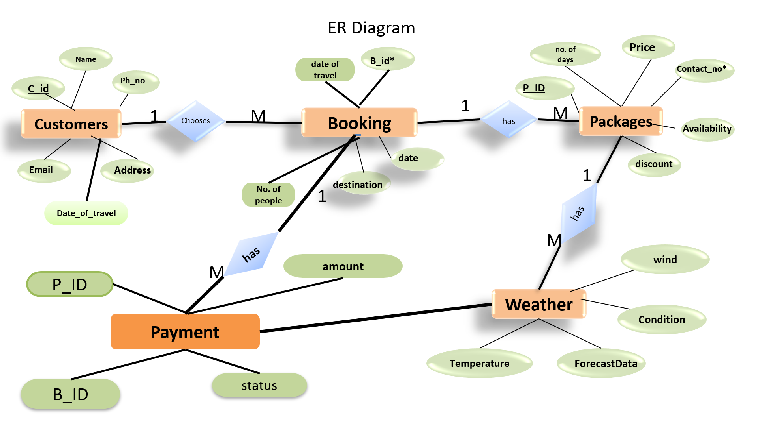
ER diagram
Notes:
Font Styles: Times New Roman + Font Size: 25

Slide 10
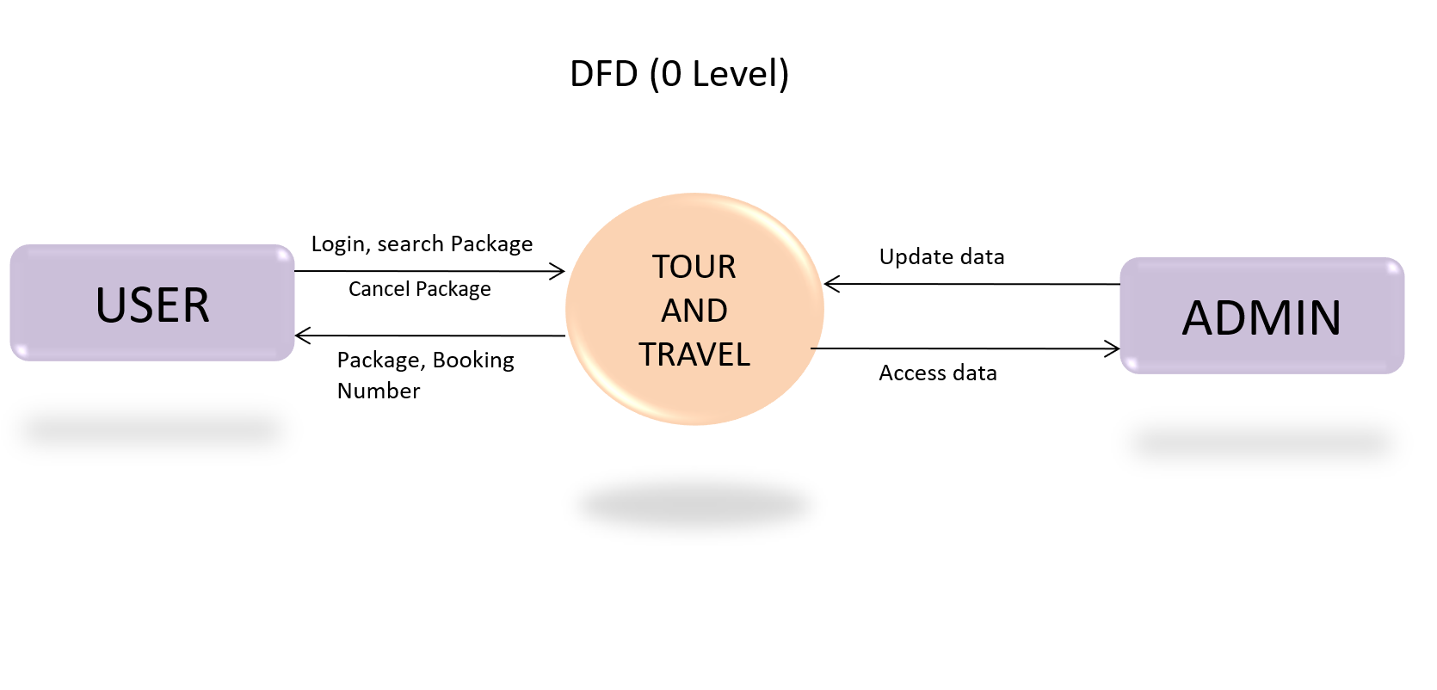
DFD 0 Level

Slide 11
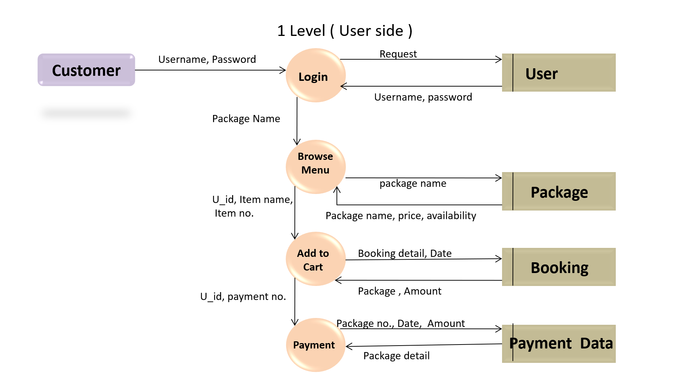
DFD 1 Level

Slide 12
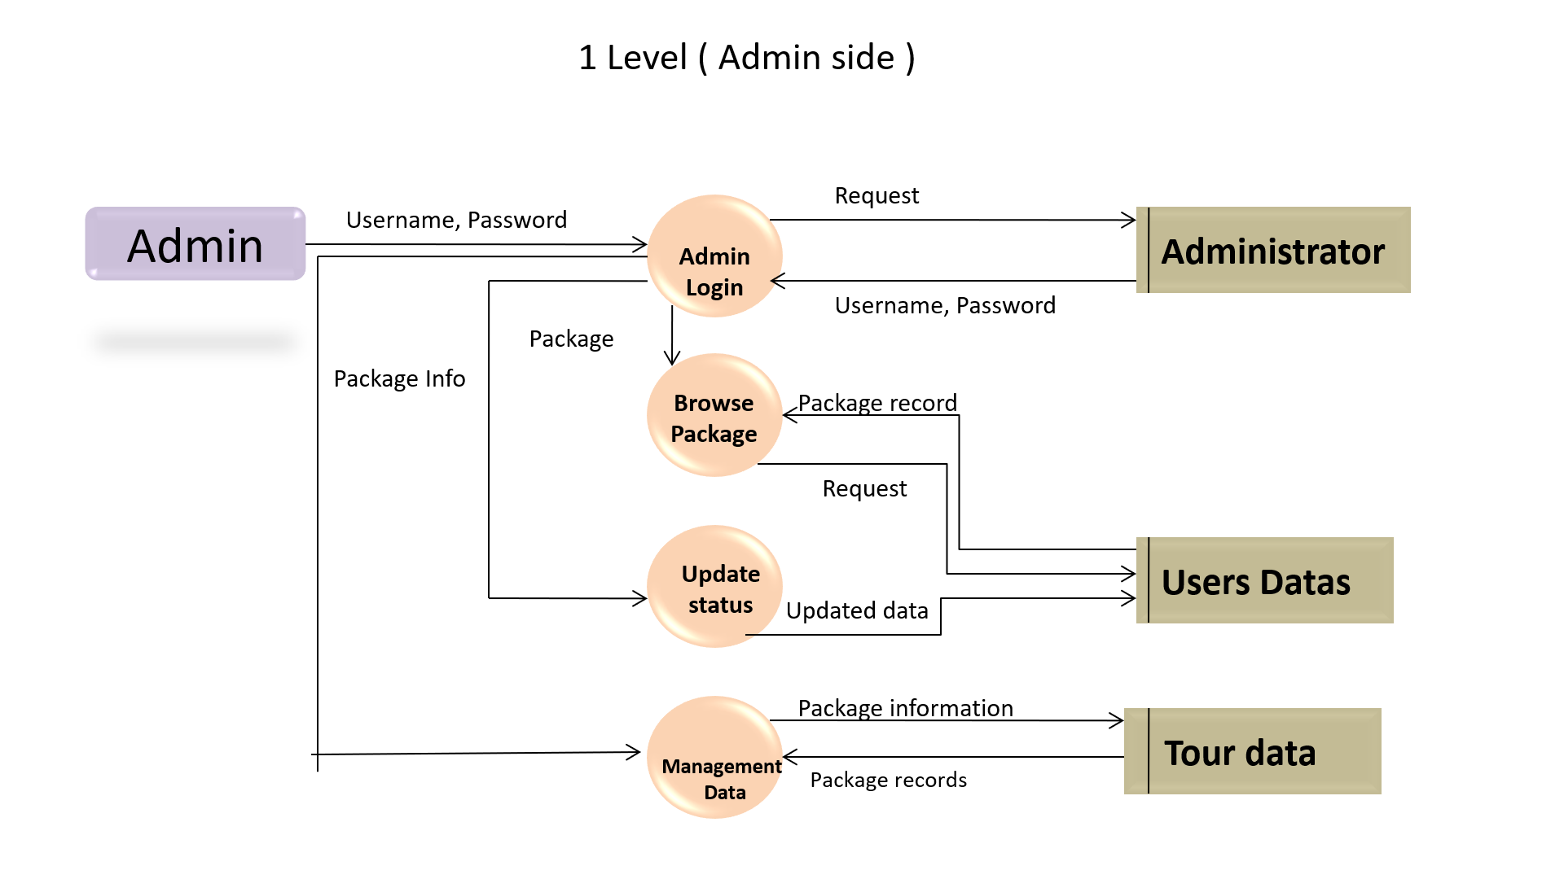
DFD 1 Level

Slide 13
Workflow/Gantt Chart
1. Pre-Tour: Research destinations, customize packages, confirm booking, process payment, handle visa/documentation.
2. Preparation: Assign guide, confirm bookings, send instructions.
3. Execution: Start tour, manage activities, provide support, collect feedback.
4. Post-Tour: Gather feedback, review services, offer future promotions.
Gantt Chart
| Task | Week 1 | Week 2 | Week 3 | Week 4 |
|--------------------|--------|--------|--------|--------|
| Pre-Tour | ●●●● | ●●● | | |
| Preparation | | ●●● | ●● | |
| Execution | | | ●●● | ●●●●● |
| Post-Tour | | | | ●●
Notes:
Font Styles: Times New Roman + Font Size: 25

Slide 14
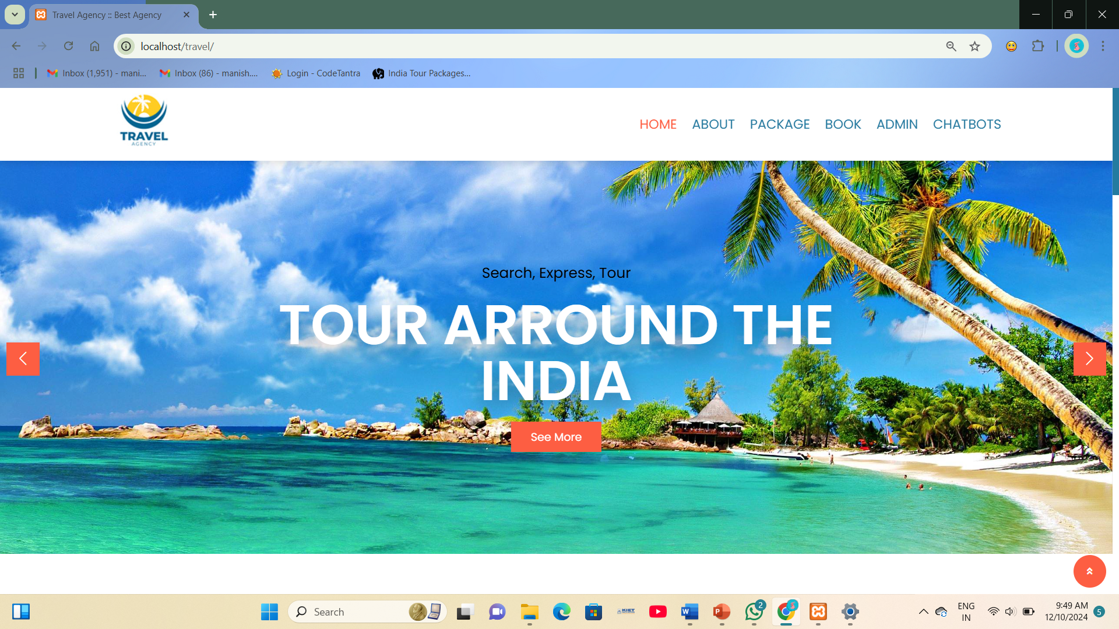
Outcome
Notes:
Font Styles: Times New Roman + Font Size: 25

Slide 15
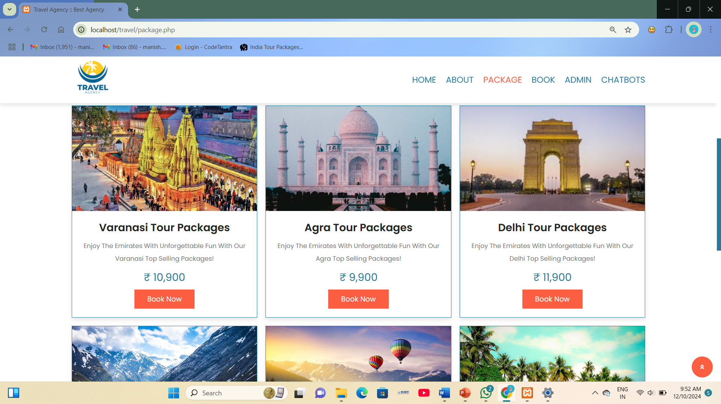
Outcome
Notes:
Font Styles: Times New Roman + Font Size: 25

Slide 16
Reports
- The tour and travel industry helps people explore new places.
- It includes transportation, hotels, and activities.
- Trends: eco-friendly travel, customized trips, and online bookings.
- Challenges: recovery from the pandemic, economic changes, and crowded tourist spots.
- Opportunities: using new technology, exploring new markets, and promoting green travel.
Notes:
Font Styles: Times New Roman + Font Size: 25

Slide 17
References
Here are some useful references on the tour and travel industry:
1. World Travel & Tourism Council (WTTC) – Reports and data on global tourism's economic impact.
- Website: [https://wttc.org](https://wttc.org)
2. UN World Tourism Organization (UNWTO) – Provides insights into international tourism trends, statistics, and policies.
- Website: [https://www.unwto.org](https://www.unwto.org)
Notes:
Font Styles: Times New Roman + Font Size: 25

Slide 18
THANK YOU

